Slide 1
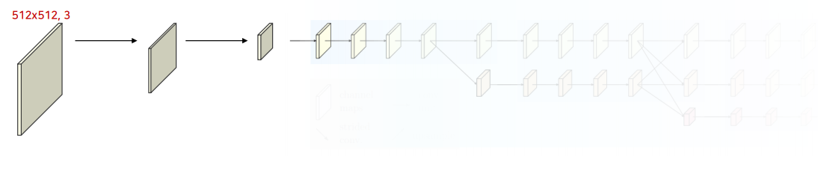
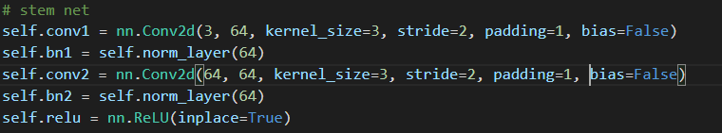
0. Stem network
128x128,64
Stride=2의 convolution을 2번 거쳐서 h/4 x w/4 크기로 만듦

Slide 2
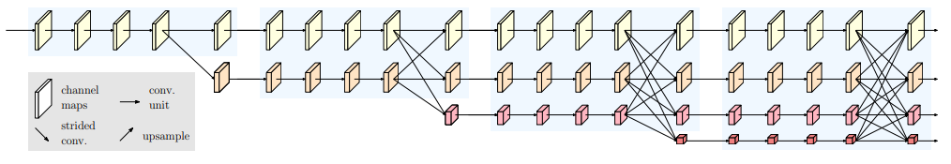
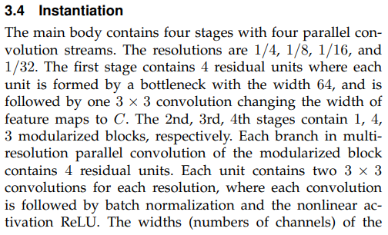
Main body
stage1
stage2
stage3
stage4
Bottleneck block
C = 32
4 residual units
C = 64
conv3x3
X 1
C = 128
C = 256
X 4
X 3
Each branch contains 4 residual units
2nd stage contain
1 modularized blocks
3rd stage contain
4 modularized blocks
4th stage contain
3 modularized blocks
Hrnet32
C = 32

Slide 3
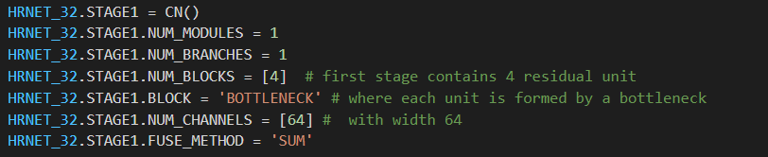
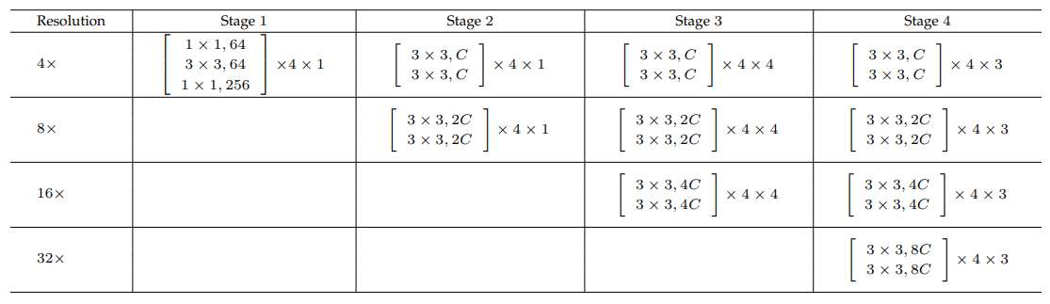
1. Main Body – stage1
stage1
Bottleneck block
128x128,64
128x128
,256
4 residual units
Table 14

Slide 4
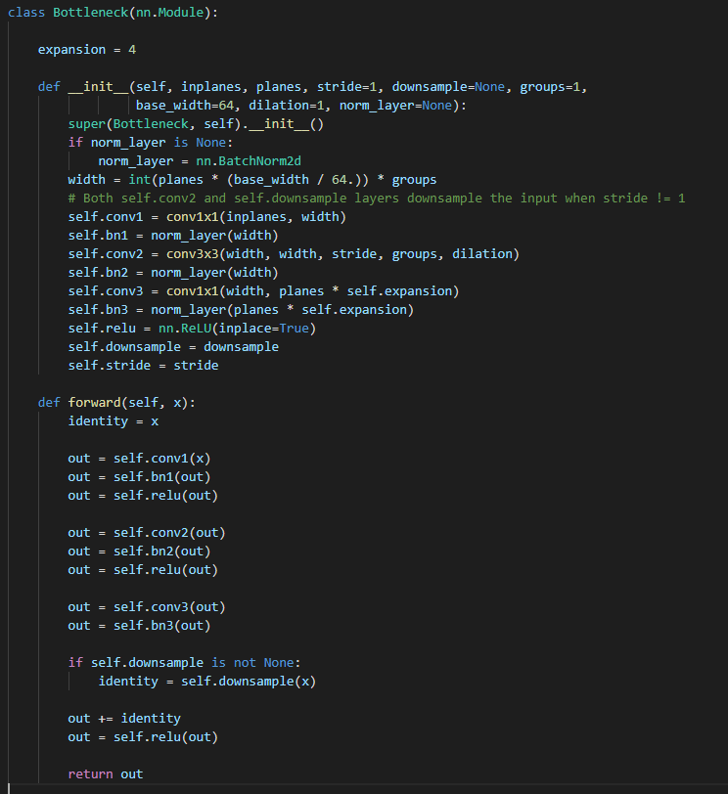
1. Main Body – stage1
Bottleneck block
128x128
,256
128x128,64
128x128
,256
128x128
,256
128x128
,256
Table 14
Conv1x1, 64
BN
Bottleneck block
relu
Conv3x3, 64
BN
relu
Conv1x1, 256
BN
relu

Slide 5
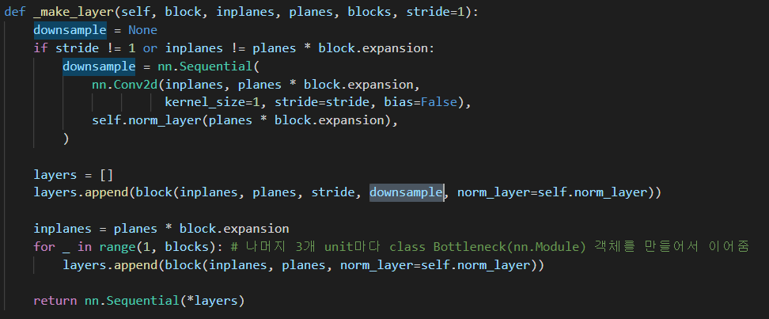
1. Main Body – stage1
128x128
,256
128x128,64
128x128
,256
128x128
,256
128x128
,256
4 residual units
첫 번째 block은 입력 채널(64)과 출력채널(256)을 맞추기 위해 conv1x1 추가
Table 14
Conv1x1, 64
BN
relu
Conv3x3, 64
BN
relu
Conv1x1, 256
BN
Conv1x1, 256
BN
relu

Slide 6
1. Main Body – stage1
Conv3x3, stride=1
(128x128, 256)
bn
(128x128, 32)
Hrnet32니까 32로 설정
relu
Conv3x3, stride=2
bn
(64x64, 64)
채널 수는 2배 증가
relu
Stride를 2로 줘서 resolution을 반으로 줄임

Slide 7
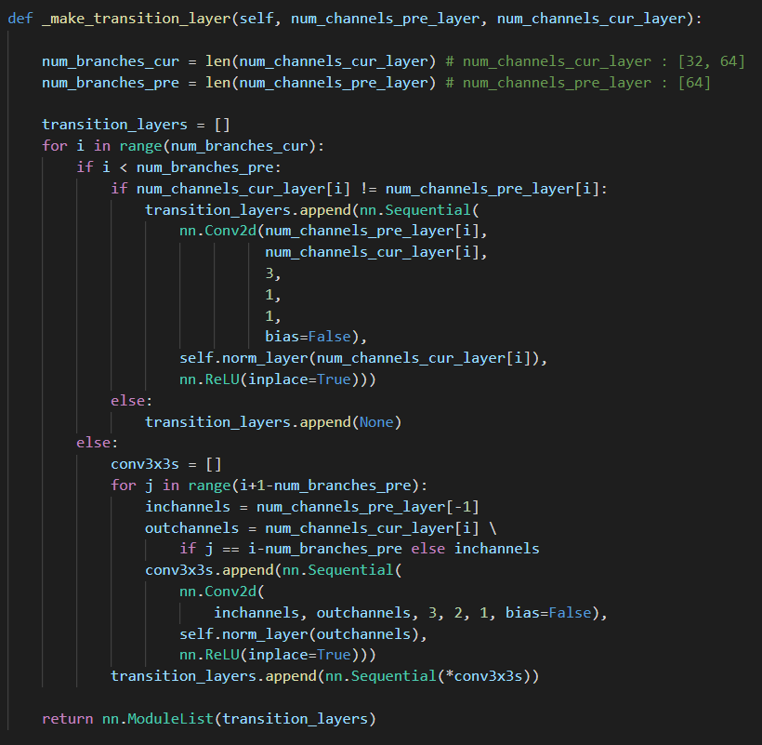
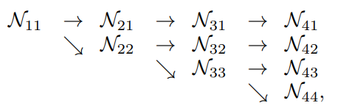
1. Main Body – stage1
Resolution 그대로
& Channel 수 변환
Resolution 그대로
& Channel 수 그대로
Resolution 절반
& Channel 수 두 배

Slide 8
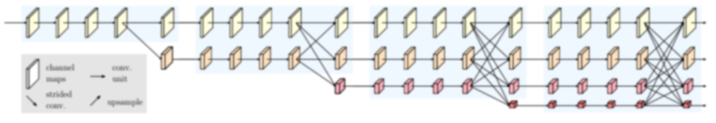

1. Main Body – stage2
BasicBlock
stage2
X 1
Each branch contains 4 residual units
2nd stage contain
1 modularized blocks

Slide 9
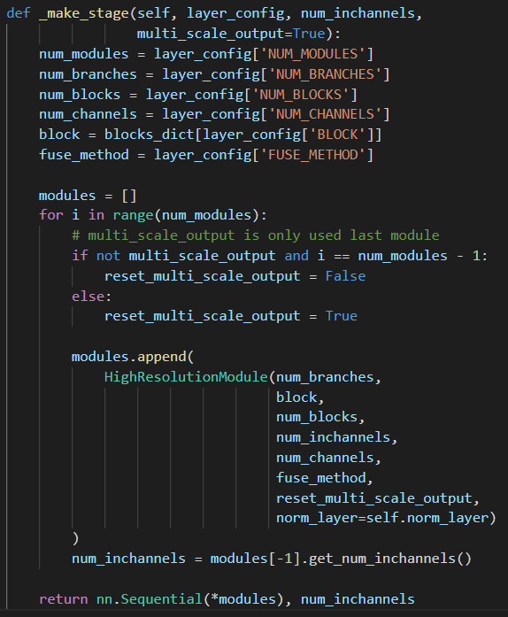
1. Main Body – stage2
BasicBlock
stage2
X 1
Stage2: 1개
Stage3: 4개
Stage4: 3개
Each branch contains 4 residual units
2nd stage contain
1 modularized blocks

Slide 10
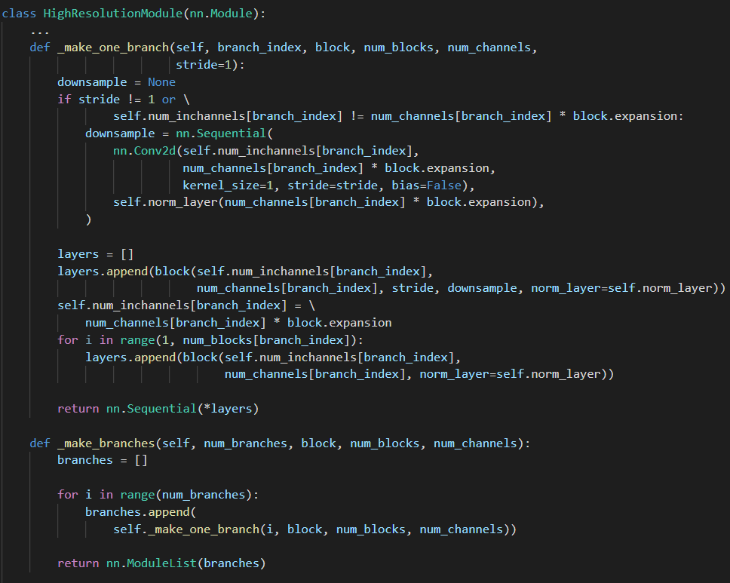
1. Main Body – stage2
Branch 2개
Branch 3개
Branch 4개
stage2에서는 2개,
stage3에서는 3개,
Stage4에서는 4개의 branch를 더함

Slide 11
1. Main Body – stage2
Modularized block
X 1
Each branch contains 4 residual units
2nd stage contain
1 modularized blocks
Modularized block
stage2에서는 2개,
stage3에서는 3개,
Stage4에서는 4개의 branch(BasicBlock)을 더해줌

Slide 12
1. Main Body – stage2
branch
block
branch 하나
- residual unit (BasicBlock) 4개로 이루어짐
- Each branch in multi-resolution parallel convolution of the modularized block contains 4 residual units.

Slide 13
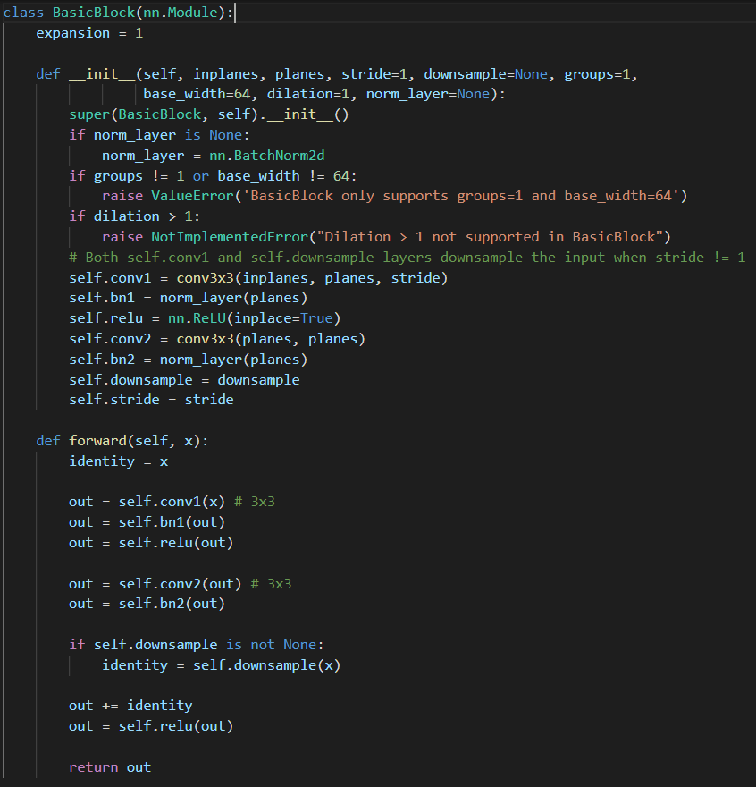
1. Main Body – stage2
residual unit (BasicBlock)
block
Conv3x3
BN
relu
Conv3x3
BN
Conv1x1
BN
relu

Slide 14
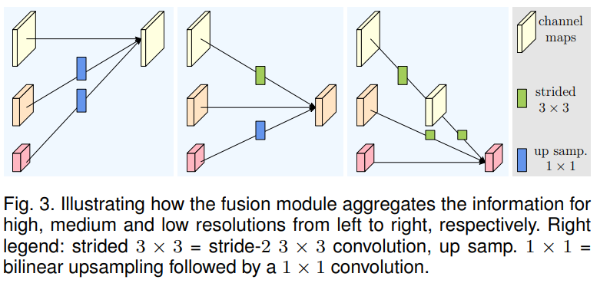
1. Main Body – stage2
128x128, 32
128x128, 32
64x64, 64
64x64, 64
- Strided Convolution으로 하위 stream 생성
- Bilinear upsampling → 1x1 Convolution으로 상위
stream 생성
32x32, 128

Slide 15
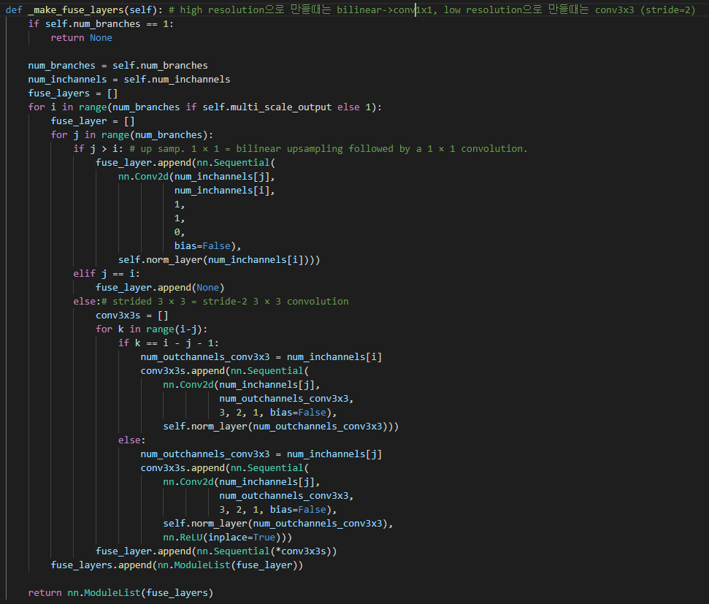
1. Main Body – stage2

Slide 16
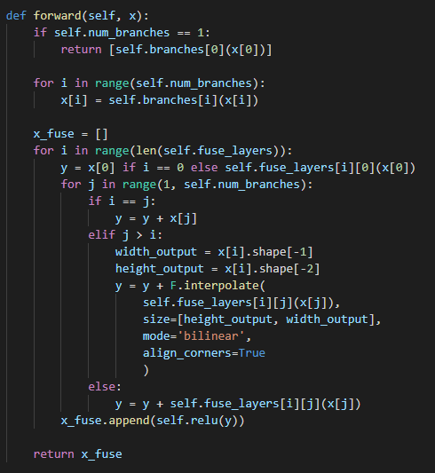
1. Main Body – stage2
Modularized block
Modularized block
X 1

Slide 17
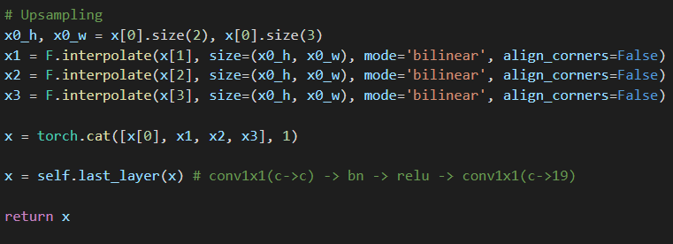
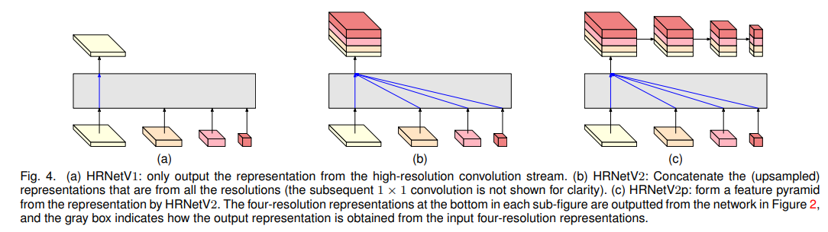
2. Last layer

